Slide 1
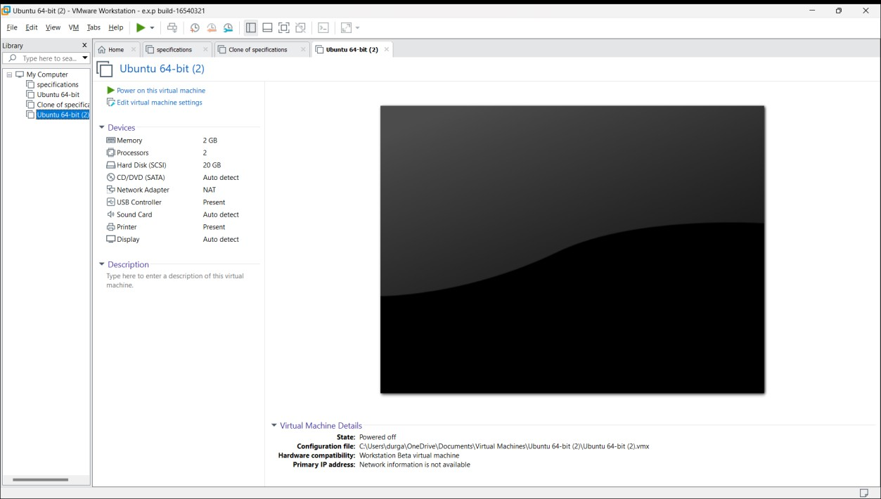
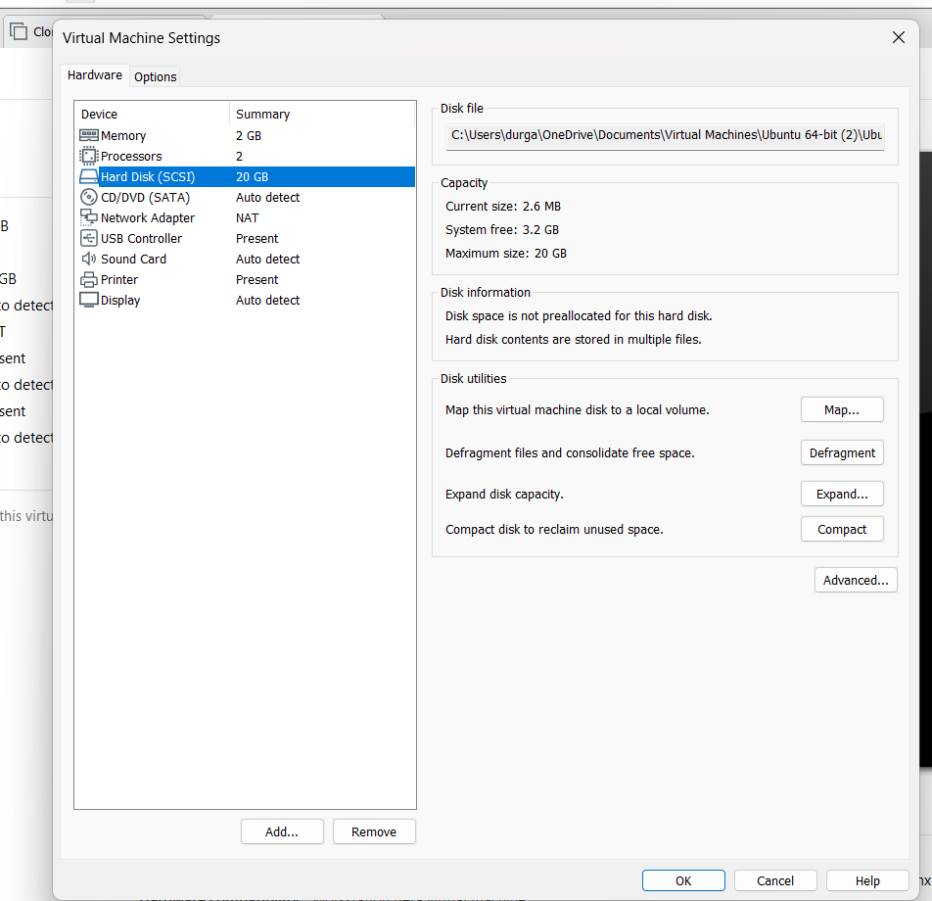
Experiment-11
Change Hardware compatibility of a VM (Either by clone/create new one) which is already created and configured.

Slide 2
